Slide 1

Wine Quality Data Set
Best Predictors for Red Wine
Junhyuk Jang, Seunghwan Hyun, Sang Ok Suh

Slide 2
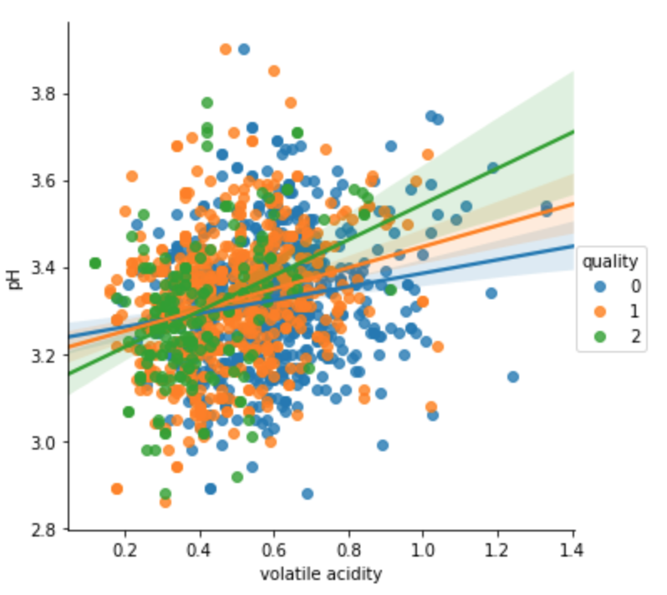
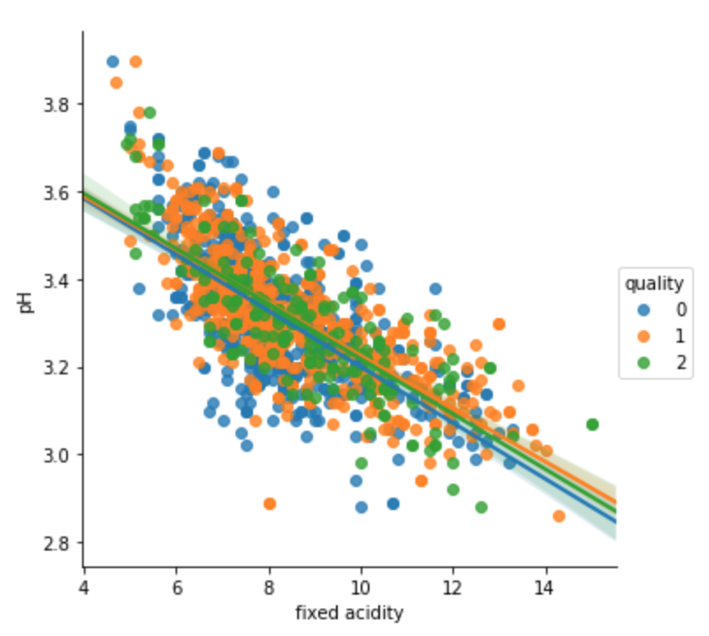
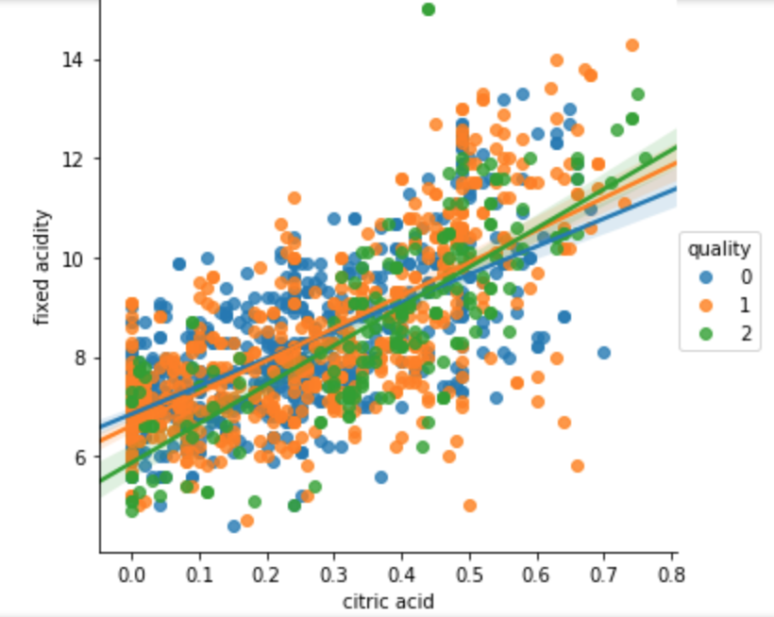
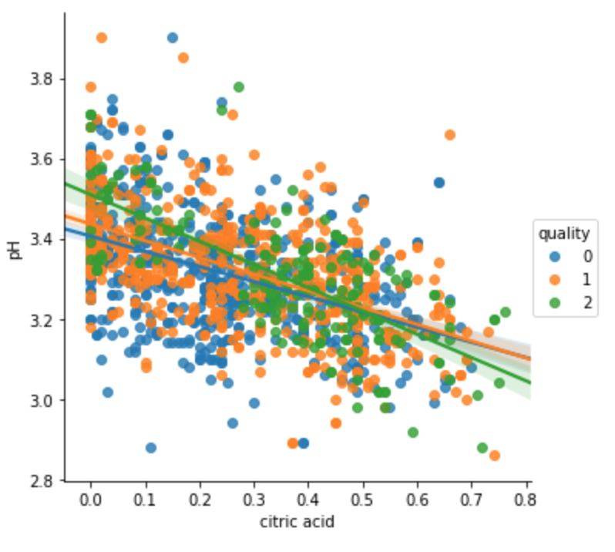
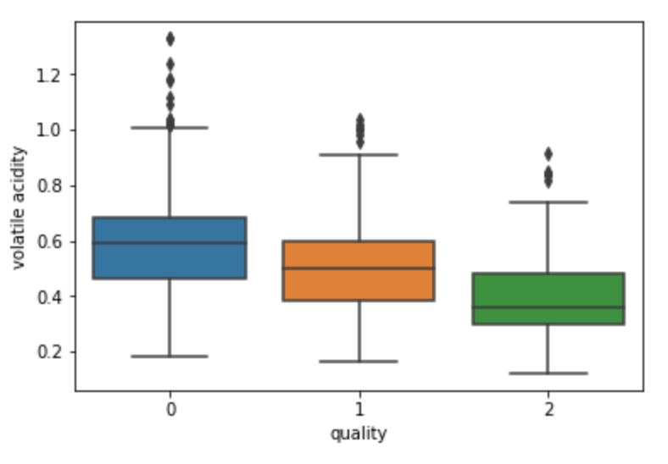
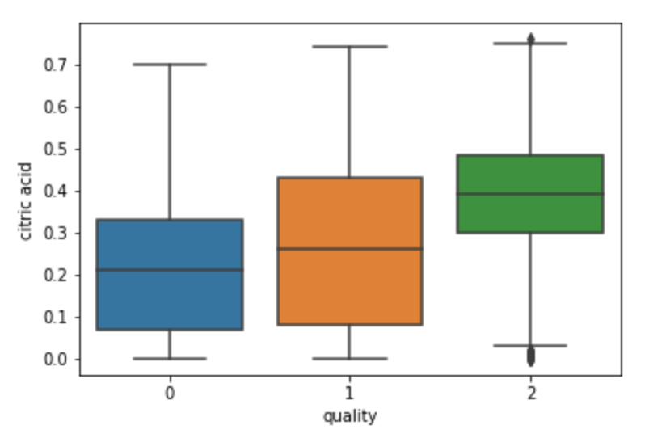
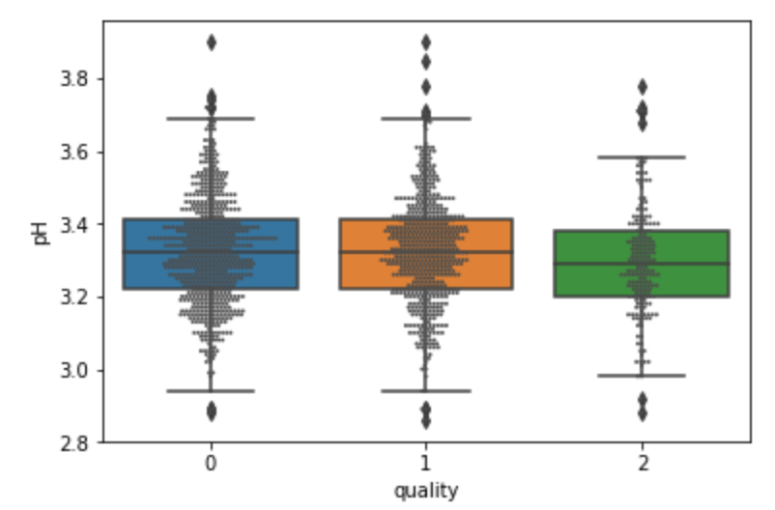
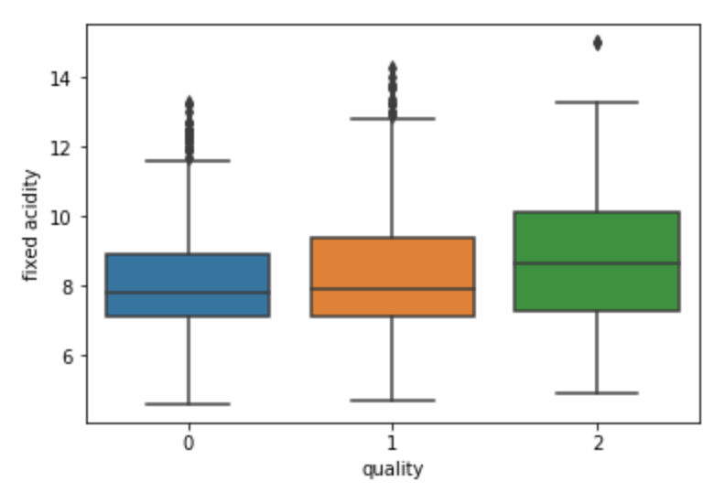
Data Exploratory
Q1. What is the relationship between the four measures of Acidity?
Volatile Acidity
Fixed Acidity
Citric Acid
Citric Acid
PH
PH
PH
Fixed Acidity
Q2. Does a significant relationship exist between Acidity and Quality of Wine?
Volatile Acidity
Fixed Acidity
Citric Acid
PH
Notes:
Based upon the above slides, we chose the predictors blah blah for white wine and blah blah for red but according to random forest blah blah.

Slide 3
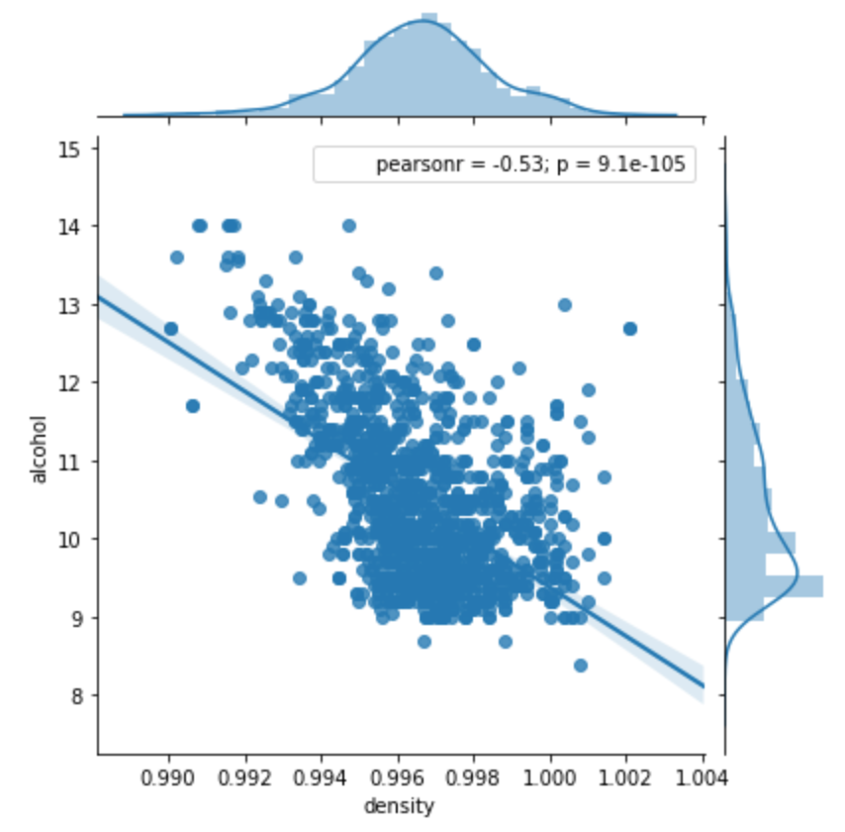
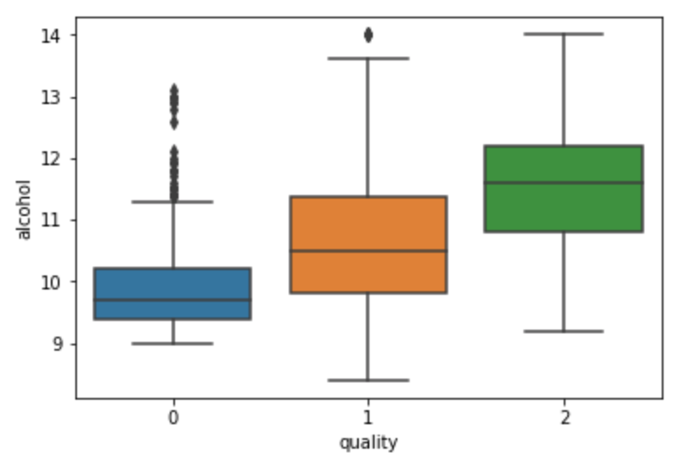
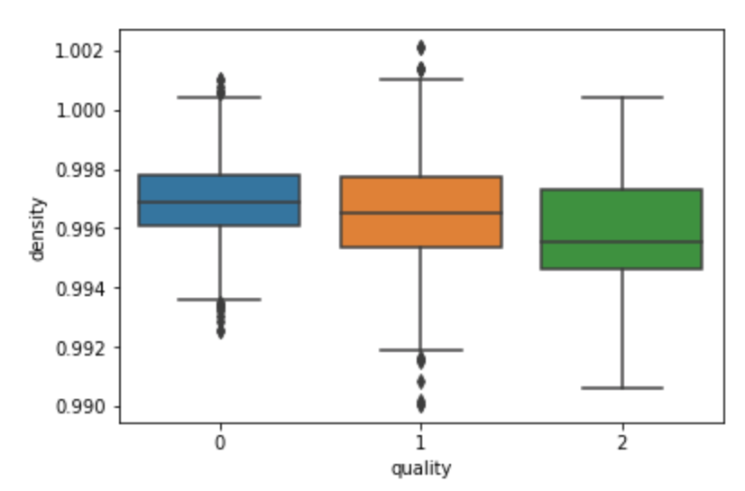
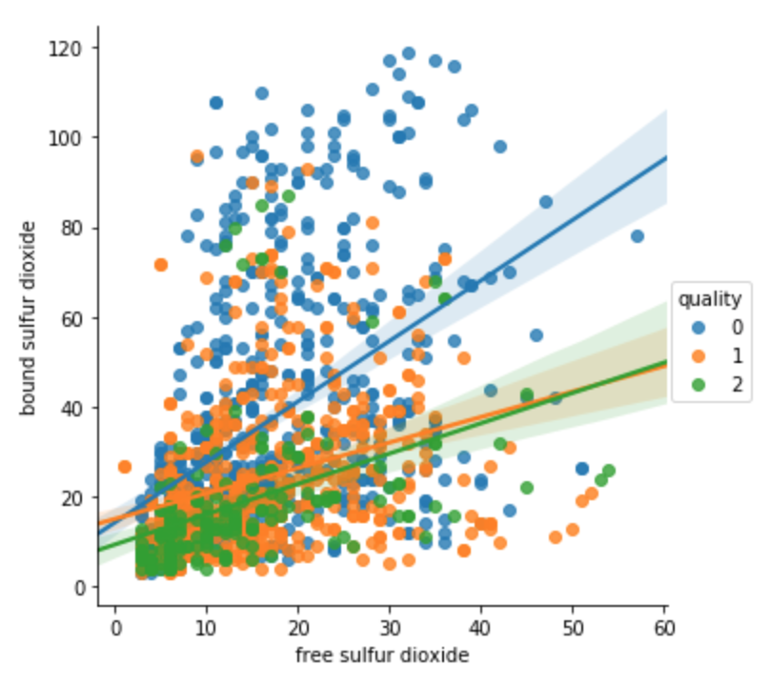
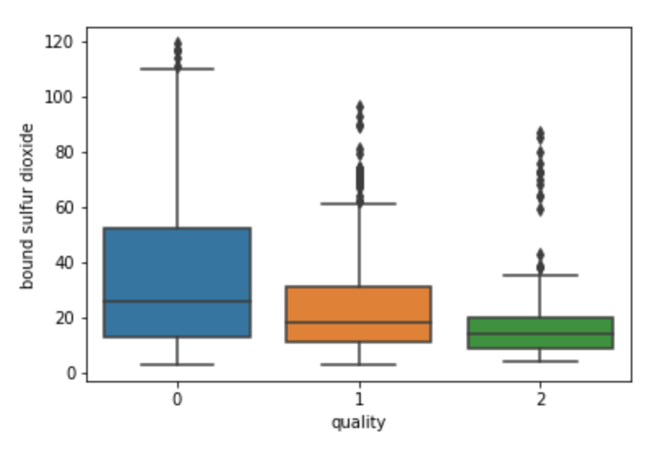
Data Exploratory
3. Does Alcohol Content and Density affect Wine Quality?
4. Is there a significant relationship between Sulfur Dioxide and Wine Quality?
Notes:
Based upon the above slides, we chose the predictors blah blah for white wine and blah blah for red but according to random forest blah blah.

Slide 4

Multinomial Logistic Regression
Full Model: Volatile Acidity, Citric Acid, Alcohol, Sulphates, Bound Sulfur Dioxide
Reduced Model: Volatile Acidity, Alcohol, Sulphates, Bound Sulfur Dioxide
Independent variables (VIF)
5-fold Cross Validation(Overfitting)
In-sample(64.95%) vs Out-sample(62.88%)
Full Model vs Reduced Model
64.93% vs 65.21% (Accuracy rate)

Slide 5
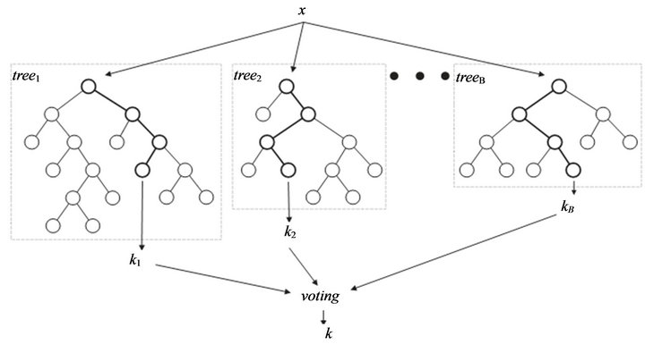
Random Forest
Train(75%), Test(25%)
Reduced Model(4 Variables)
Accuracy rate: 75.07%
Full Model(5 Variables)
Accuracy rate: 74.25%

Slide 6

Conclusion
Multinomial Logistic Random Forest Regression
VS
VS

